Slide 1
Employee Data Analysis using Excel
STUDENT NAME :
STUDENT NAME : S. AANCHANA DEVI
REGISTER NO : 312214973
DEPARTMENT : COMMERCE
COLLEGE : SOKA IKEDA COLLEGE OF ARTS AND SCIENCE FOR WOMEN

Slide 2
PROJECT TITLE
Employee Performance Analysis using Excel

Slide 3


AGENDA
Problem Statement
Project Overview
End Users
Our Solution and Proposition
Dataset Description
Modelling Approach
Results and Discussion
Conclusion
3/21/2024 Annual Review

Slide 4

PROBLEM STATEMENT
Suppose your problem statement is analysis the monthly performance of employees in a sales department to identify high performers and those needing improvement .You’ll typically start by identifying key performance indicators (KPIs)relevant to your problem statement.Here’s a step-by-step guide.
1.Data collection
•Employee details
•performance metrics
•Time frame
2. Data entry in excel
Create a spreadsheet with the necessary columns :
•column A: Employee ID
•column B: Employee Name
• column C: Sales volume
•column D: Sales Target. (Etc….)
3.Data Analysis
•Calculate performance metrics
• conditional formatting
•pivot Tables

Slide 5

PROJECT OVERVIEW
Here’s a step by step guide on how to set up your excel spreadsheet to perform this analysis based on a project overview:
1.Data collection
• Employee information
•project details
•performance metrics
2.create the excel workbook
•Sheet 1: Employee data
•Sheet2: Project data
•Sheet 3: Performance Metrics
3. Data Analysis
•Calculate averages and total
•Create pivot tables
•Use conditional formatting
• performance rating calculation
4. Visualisation
• Create charts
•Dashboards

Slide 6

WHO ARE THE END USERS?
The end users of an employee performance analysis using typically include:
1.Managers/Supervisors
2. HR professionals
3.Employees
4. Executives
5.Performance review committee
6. Business analysts
Each group uses the analysis to fulfill their specific role in the organisation, leveraging the insights to drive better outcomes and improve over all company performance.

Slide 7

OUR SOLUTION AND ITS VALUE PROPOSITION
•To calculate the performance level of the data a formula is used
=IFS(Z8>=5,”VERY HIGH”,Z8>=4,”HIGH”,Z8>=3,”MED”, TRUE,”LOW”).
•To identify the missing values, conditional format function is used in the Excel.
• Elimination of missing values is done by the filter function
• Pivot table is created to summarise the employee data performance.
• great function is used to visualize the data.

Slide 8
Dataset Description
Employee –Kaggle
26 – Features
Name – Alphabetical
Performance level – Numericals value
Employee types – Alphabetical
Employee rating – Numerical value
Business Unit - Alphabatical

Slide 9

THE "WOW" IN OUR SOLUTION
HFSI8-5. Very high. Z8..... 4 High. Z8 -3 medium true love
The above formula used to categories the performance level of the employee is consider.
3/21/2024 Annual Review
9

Slide 10
MODELLING
Analysis employee performance in excel involves gathering relevant data creating models and using various excel functions and tools to evaluate performance metrics. Here’s a basic guide on how to approach this
1.Gather data
•Collect employee data
• set KPIs
2. Data Organisations
•Create data table
• add a data column
3. Data analysis using excel function
• calculate performance matrix’s
• Weighted average
4. Using excel tools for analysis
•Pivot tables
• Conditional formatting
5. Employee performance model example
• rating model
• performance index
6. Forecasting and trend analysis
• Trendlines
• forecasting
10

Slide 11
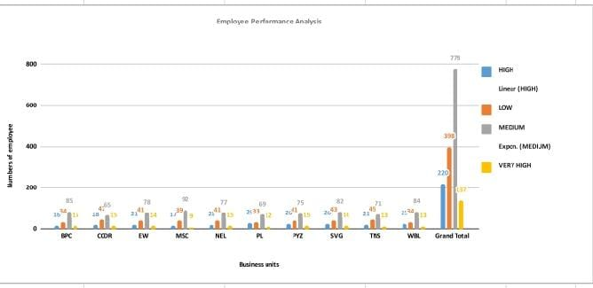
RESULTS
11

Slide 12
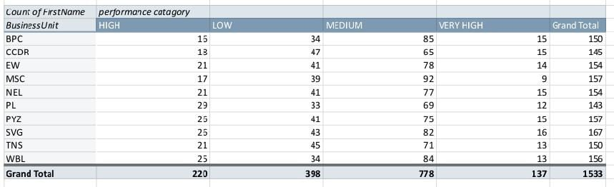

Slide 13
conclusion
The analysis of employee performance reveals server key insights.firstly for insurance, employee in consistently perform above indicating. Conversely has shown areas needing improvement, particularly in specific metrics or behaviour.
Comparing performance against company bench marks , mention any significant deviation or alignments . For example specific observation which suggests that implication of the observation
Patterns observed include describe any relevant patterns. This correlation between and performance outcome highlights .

